Slide 1
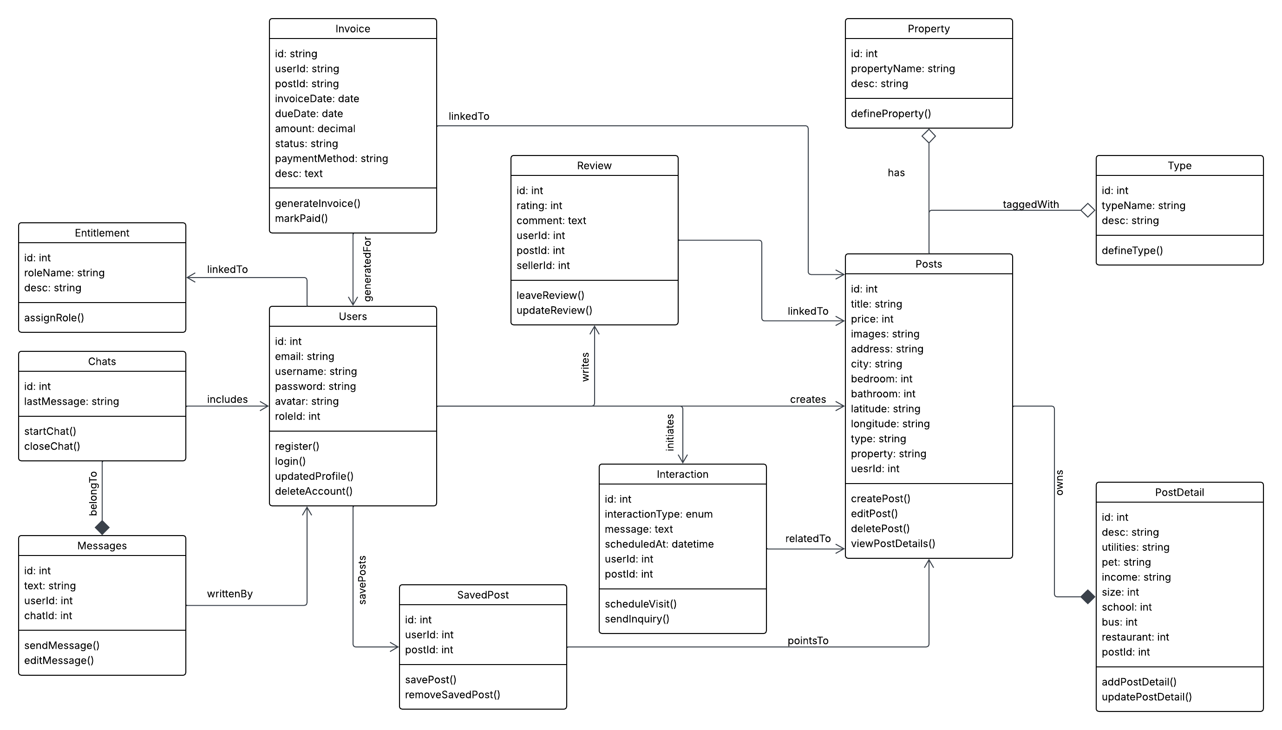
UML Class Diagram - HouseHunt

